Slide 1

Inventory management system
Ayush Mistry
Sahil Mujumdar
Tanvi Mirgal
Urvi Padelkar

Slide 2
Inventory Management System
Inventory management software is a software system used for tracking inventory levels, orders, sales and deliveries.
It can also be used in the manufacturing industry to create a work order, bill of materials and other production-related documents.
Companies use inventory management software to avoid product overstock and outages.
It is a tool for organizing inventory data that before was generally stored in hard-copy form or in spreadsheets.

Slide 3
OBJECTIVES:
Companies often use inventory management software to reduce their carrying costs.
The software is used to track products and parts as they are transported from a vendor to a warehouse, between warehouses, and finally to a retail location or directly to a customer.
Inventory management software is used for a variety of purposes, including:
Maintaining a balance between too much and too little inventory.
Tracking inventory as it is transported between locations.
Receiving items into a warehouse or other location.
Picking, packing and shipping items from a warehouse.
Keeping track of product sales and inventory levels.
Cutting down on product obsolescence and spoilage.
Avoiding missing out on sales due to out-of-stock situations.

Slide 4
Features:
Purchase
management
Reporting of business activity
Alerts and updates regarding the inventory details
Payment Gateway
Warehouse Management
Forecasting of the inventory
Manages Demand and supply of the product

Slide 5
Block Diagram:
Inventory Management Home page
Search Page
Display Purchase

Slide 6
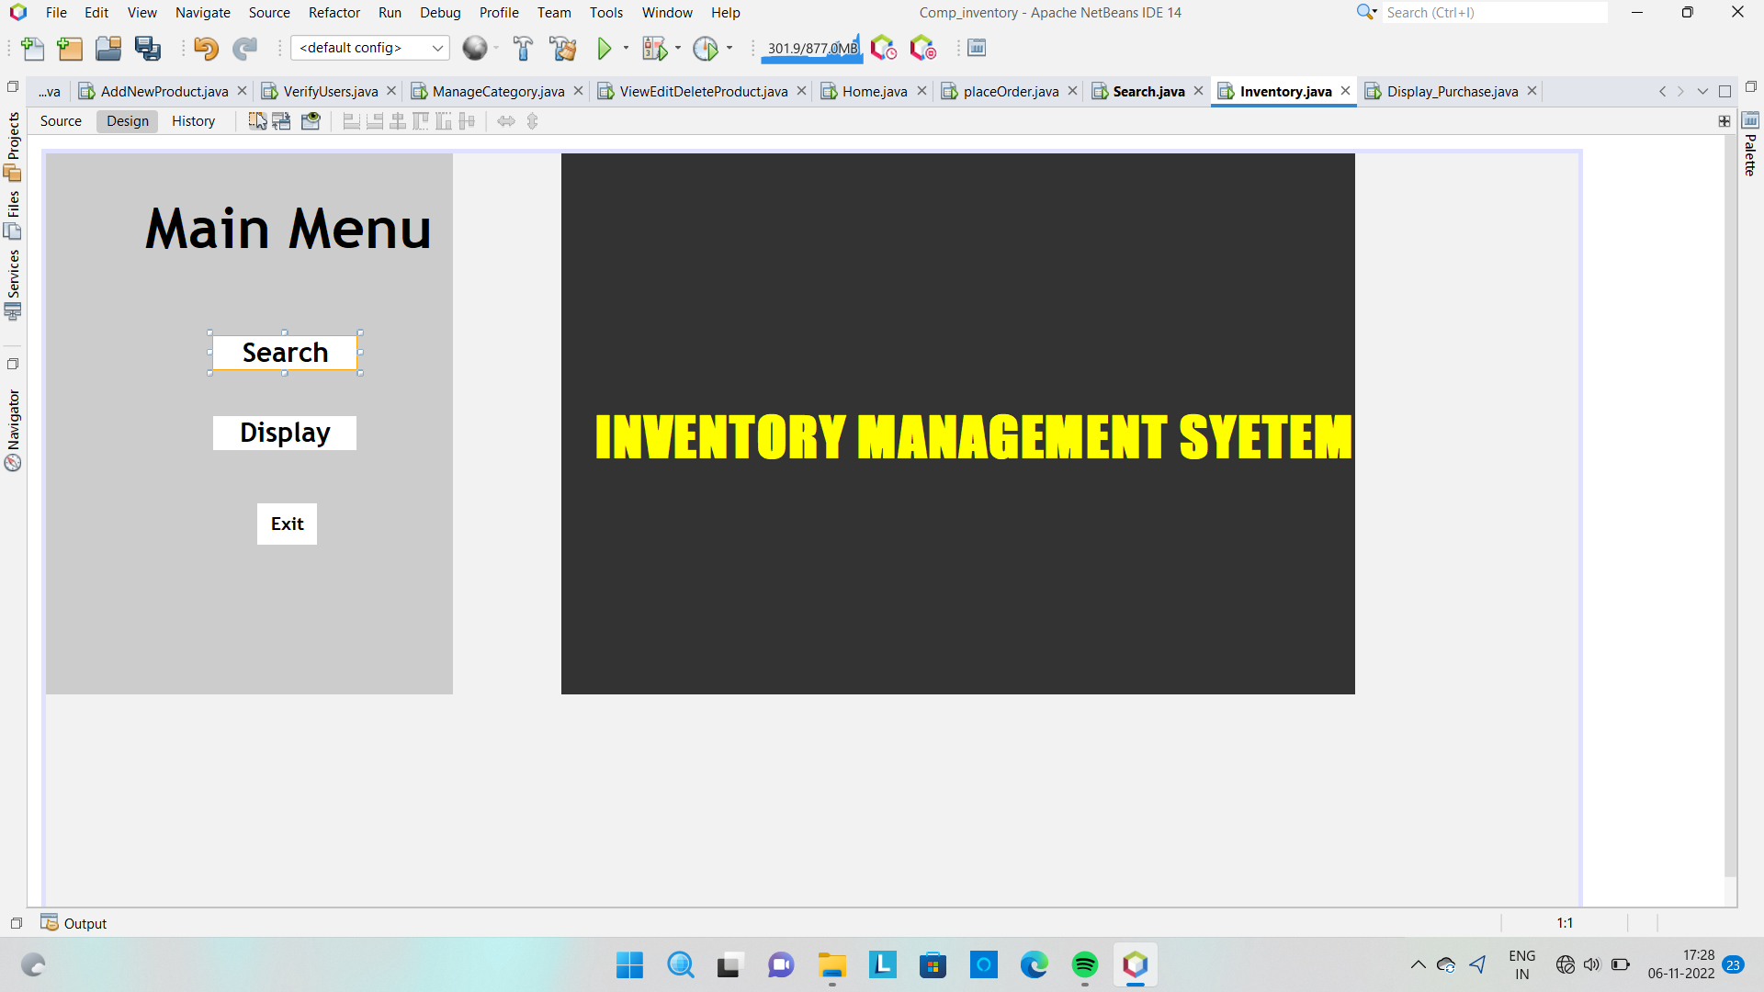
Output screenshots:

Slide 7
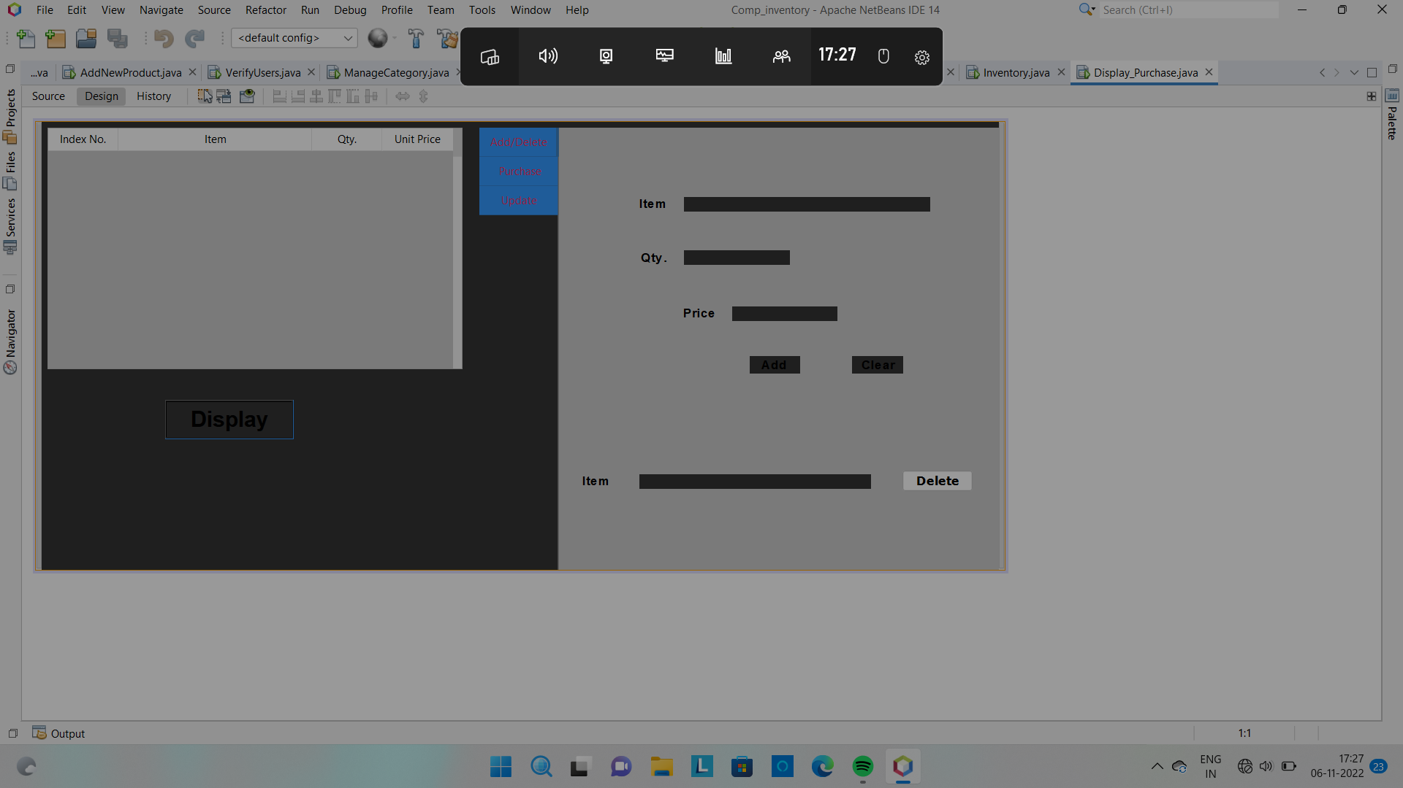
Output screenshots:

Slide 8
Thank You

